Slide 1
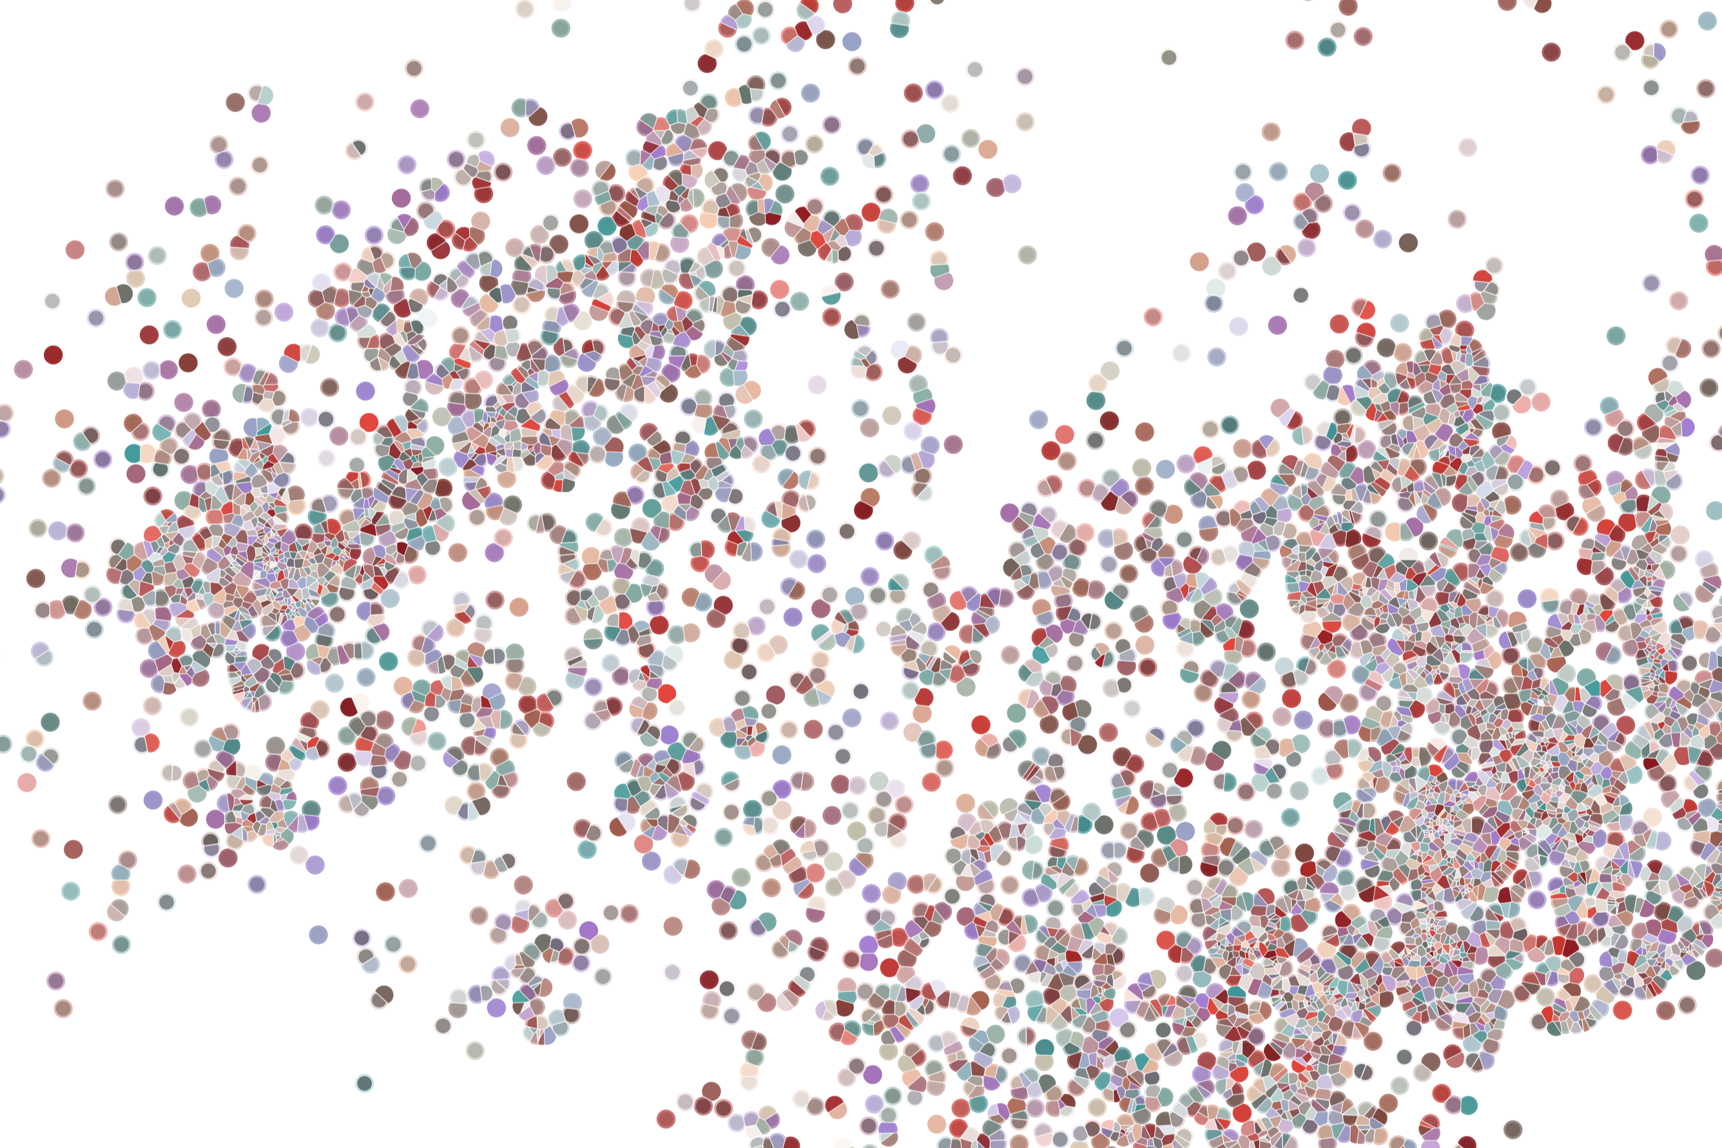
Lecture 4 Comparing chromatin accessibility across cells / samples
Physalia workshop 2021 — Bulk and single-cell ATAC-seq analysis
Instructor: Jacques Serizay
Notes:
Hello everybody and thank you for attending my presentation. I am going to talk about the project I recently started working on in the Spassky and Koszul labs, both located in Paris. This project focuses on the unusual cooption of the mitotic machinery to drive, not cell division but cell differentiation.

Slide 2

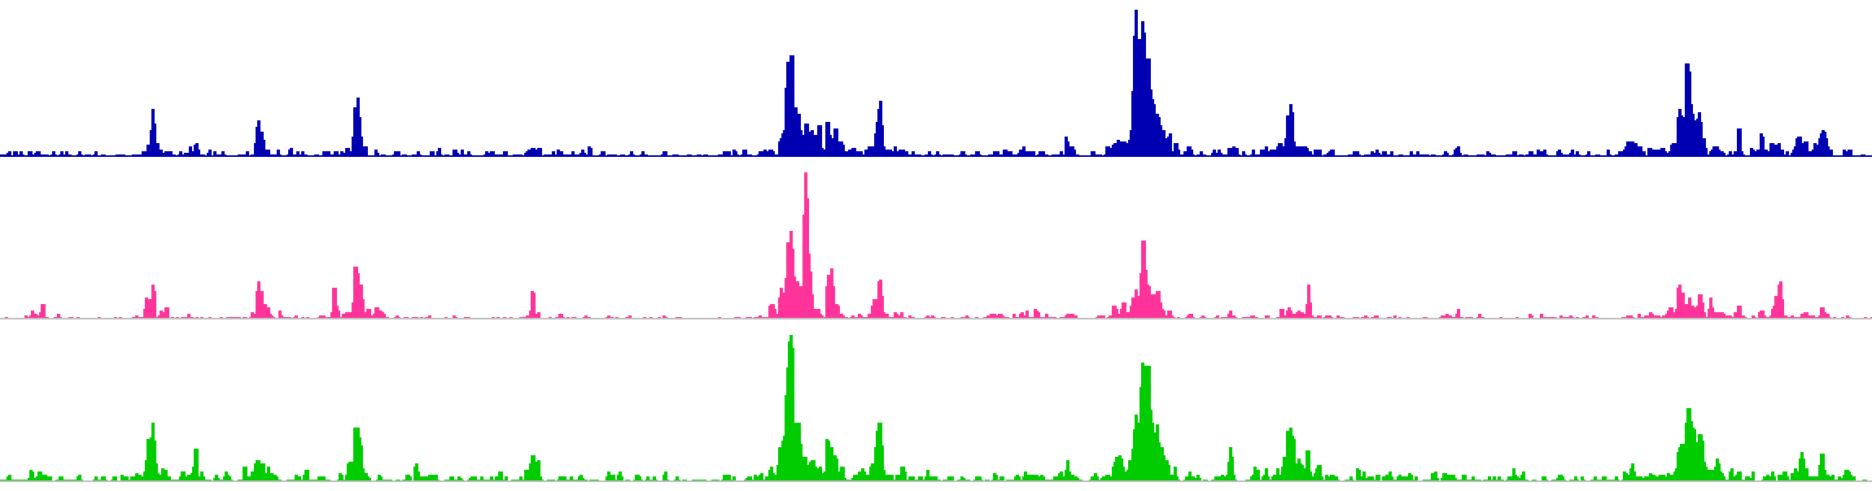
Peaks are inherently different in bulk versus single cell ATAC-seq
Bulk ATAC-seq coverage tracks are dense, with a large dynamic range.
2
Notes:
I would like to expand these observations to in vivo data. I also want to check what happens in terms of transcriptional dynamics in cells where Cyclin O, a key non-canonical cyclin involved in MCC diff., is knocked-out.

Slide 3
Peaks are inherently different in bulk versus single cell ATAC-seq
Single-cell ATAC-seq coverage tracks are sparse and binarized.
3
Notes:
I would like to expand these observations to in vivo data. I also want to check what happens in terms of transcriptional dynamics in cells where Cyclin O, a key non-canonical cyclin involved in MCC diff., is knocked-out.

Slide 4
Peaks are inherently different in bulk versus single cell ATAC-seq
Differential accessibility analysis is routinely performed with bulk ATAC-seq, but much less with single-cell ATAC-seq (notably because it’s much more recent).
Bulk ATAC-seq (n samples)
e.g. MACS2
Finding all peaks
e.g. subread
Counting coverage
e.g. DESeq2
Differential accessibility analysis
4
Notes:
I would like to expand these observations to in vivo data. I also want to check what happens in terms of transcriptional dynamics in cells where Cyclin O, a key non-canonical cyclin involved in MCC diff., is knocked-out.

Slide 5
Peaks are inherently different in bulk versus single cell ATAC-seq
Single-cell ATAC-seq can be grouped by cell clusters to generate “pseudo-bulk” samples.
e.g. Signac
Single-cell ATAC-seq (m cells)
Cell clustering (k clusters)
sinto
Bulk ATAC-seq (n samples)
Pseudo-bulk ATAC-seq (k samples)
e.g. MACS2
Finding all peaks
e.g. subread
Counting coverage
e.g. DESeq2
Differential accessibility analysis
5
Notes:
I would like to expand these observations to in vivo data. I also want to check what happens in terms of transcriptional dynamics in cells where Cyclin O, a key non-canonical cyclin involved in MCC diff., is knocked-out.

Slide 6
Peaks are inherently different in bulk versus single cell ATAC-seq
Single-cell ATAC-seq can be grouped by cell clusters to generate “pseudo-bulk” samples.
e.g. Signac
Single-cell ATAC-seq (m cells)
Cell clustering (k clusters)
sinto
Bulk ATAC-seq (n samples)
Pseudo-bulk ATAC-seq (k samples)
e.g. MACS2
Finding all peaks
Finding all peaks
e.g. subread
Counting coverage
Counting coverage
e.g. DESeq2
Differential accessibility analysis
Differential accessibility analysis
6
Notes:
I would like to expand these observations to in vivo data. I also want to check what happens in terms of transcriptional dynamics in cells where Cyclin O, a key non-canonical cyclin involved in MCC diff., is knocked-out.

Slide 7

(pseudo-) bulk count matrix
A (pseudo-) bulk count matrix is a dense (generally close to full) matrix, each column being a sample (or cell cluster) and each row being an accessible chromatin locus.
samples
A
B
C
D
1
2
3
loci
4
5
n
7
Notes:
I would like to expand these observations to in vivo data. I also want to check what happens in terms of transcriptional dynamics in cells where Cyclin O, a key non-canonical cyclin involved in MCC diff., is knocked-out.

Slide 8
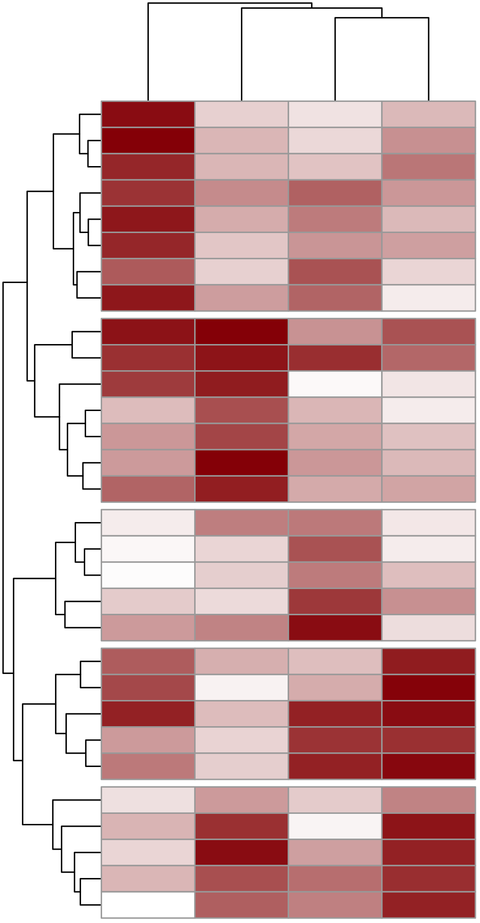
(pseudo-) bulk count matrix clustering
It can be clustered using traditional mathematical approaches, such as:
Unsupervised clustering: e.g. hirearchical clustering (hclust()), k-means (kmeans()), k-medoids (pam())
Semi-supervised clustering” e.g. seeded k-means
Supervised clustering: e.g. manually, Support Vector Machines (svm), random forest, …
samples
A
B
C
D
1
2
e.g.
k-means
3
loci
4
5
n
8
Notes:
I would like to expand these observations to in vivo data. I also want to check what happens in terms of transcriptional dynamics in cells where Cyclin O, a key non-canonical cyclin involved in MCC diff., is knocked-out.

Slide 9
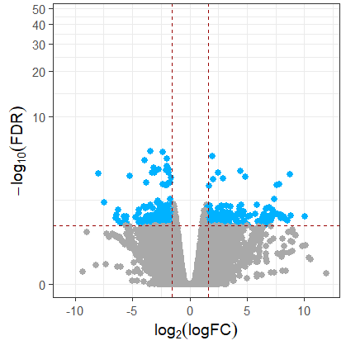
(pseudo-) bulk count matrix clustering
Manually, one can directly define sets of chromatin features using results of DA analysis.
Sample 1
Sample 2
9
Notes:
I would like to expand these observations to in vivo data. I also want to check what happens in terms of transcriptional dynamics in cells where Cyclin O, a key non-canonical cyclin involved in MCC diff., is knocked-out.

Slide 10
(pseudo-) bulk count matrix clustering
Manually, one can directly define sets of chromatin features using results of DA analysis.
Up in
Sample 2
Up in
Sample 1
Down in
Sample 1
Down in
Sample 2
10
Notes:
I would like to expand these observations to in vivo data. I also want to check what happens in terms of transcriptional dynamics in cells where Cyclin O, a key non-canonical cyclin involved in MCC diff., is knocked-out.

Slide 11
A word on replicates…
Differential accessibility analysis typically requires replicates to confidently estimate fold-change between conditions.
Bulk ATAC-seq experiments are generally performed with many replicates (at least two), so that is ok.
11
Notes:
I would like to expand these observations to in vivo data. I also want to check what happens in terms of transcriptional dynamics in cells where Cyclin O, a key non-canonical cyclin involved in MCC diff., is knocked-out.

Slide 12
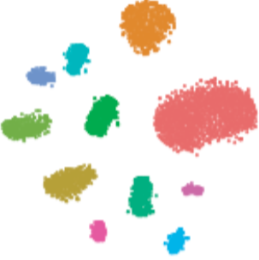


A word on replicates…
For single-cell ATAC-seq, pseudo-replicates can be generated by merging several single-cell datasets together, then clustering on the merged data and re-splitting individual replicates.
B
Integrate replicates
Cluster cells
Annotate clusters
G
C
F
A
H
L
D
E
I
J
K
samples
Split replicates
A1
A2
B1
B2
1
Recover counts per replicate and per cluster
A
C
K
2
E
G
loci
3
L
A
F
C
D
H
4
F
D
5
K
L
B
J
G
I
B
I
H
J
n
12
Notes:
I would like to expand these observations to in vivo data. I also want to check what happens in terms of transcriptional dynamics in cells where Cyclin O, a key non-canonical cyclin involved in MCC diff., is knocked-out.

